Slide 1


Social Buzz:
Content category analysis

Slide 2


Today's agenda
Project recap
Problem
The Analytics team
Process
Insights
Summary

Slide 3

Social Buzz is an online social media and content creation platform that has a reach of over 500 million active users each month.
The company has scaled quicker than anticipated and needs the help of an advisory firm to oversee the scaling process effectively.
Due to its rapid growth and digital nature of its core product, Social Buzz generates huge amounts of data that is becoming sophisticated and expensive to maintain.
Social Buzz is in need of an audit of its big data practice, recommendations for a successful IPO, and an analysis of its content to determine the most popular categories
Project Recap

Slide 4


Problem
Identify the top 5 most popular content categories from available data.

Slide 5



The Analytics team
Andrew Fleming (Chief Technical Architect)
Marcus Rompton (Senior Principle)
Toluwani Osabiya (Data Analyst)

Slide 6
Process
1. Collect data from Social Buzz
2. Identify relevant data to solve the problem
3. Inspect and clean selected datasets
4. Analyse available data
5. Visualize data

Slide 7
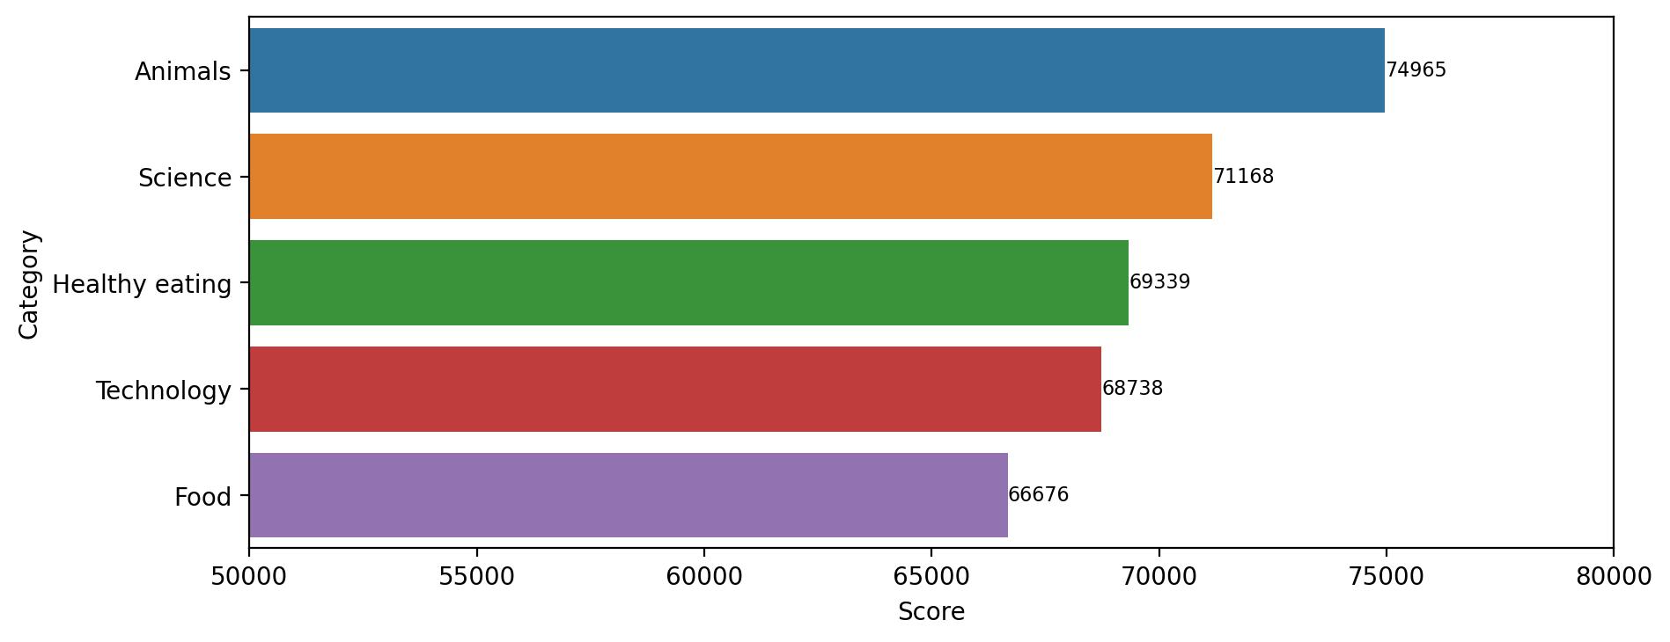
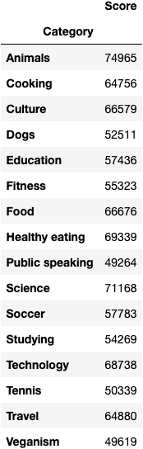

Insights

Slide 8
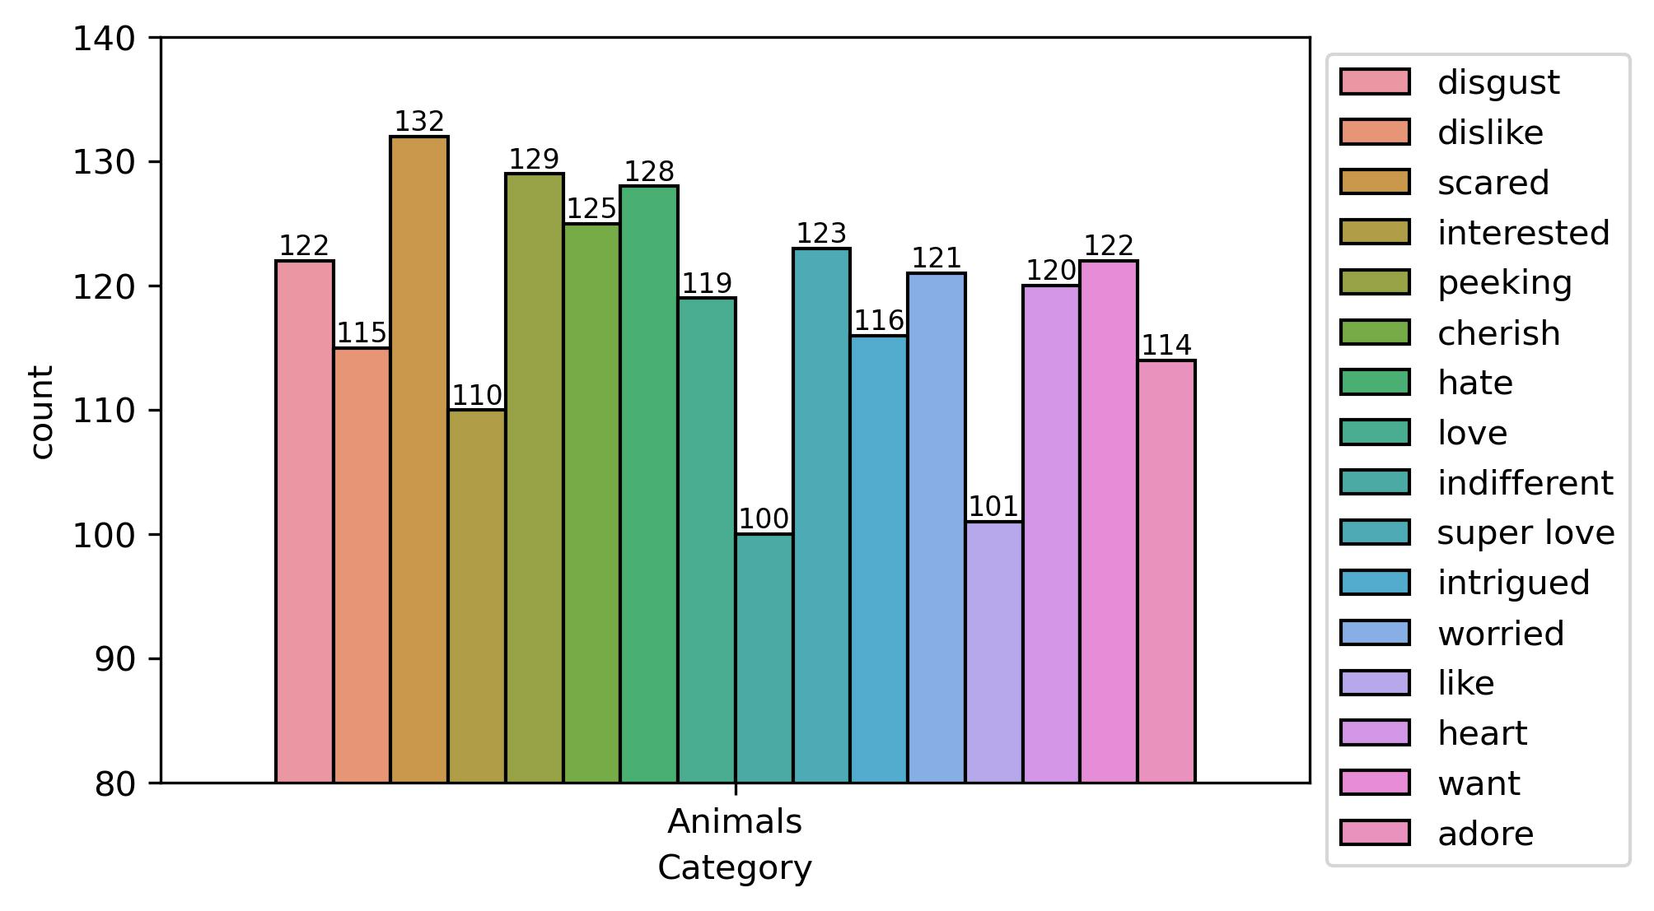
Reactions for the top category

Slide 9
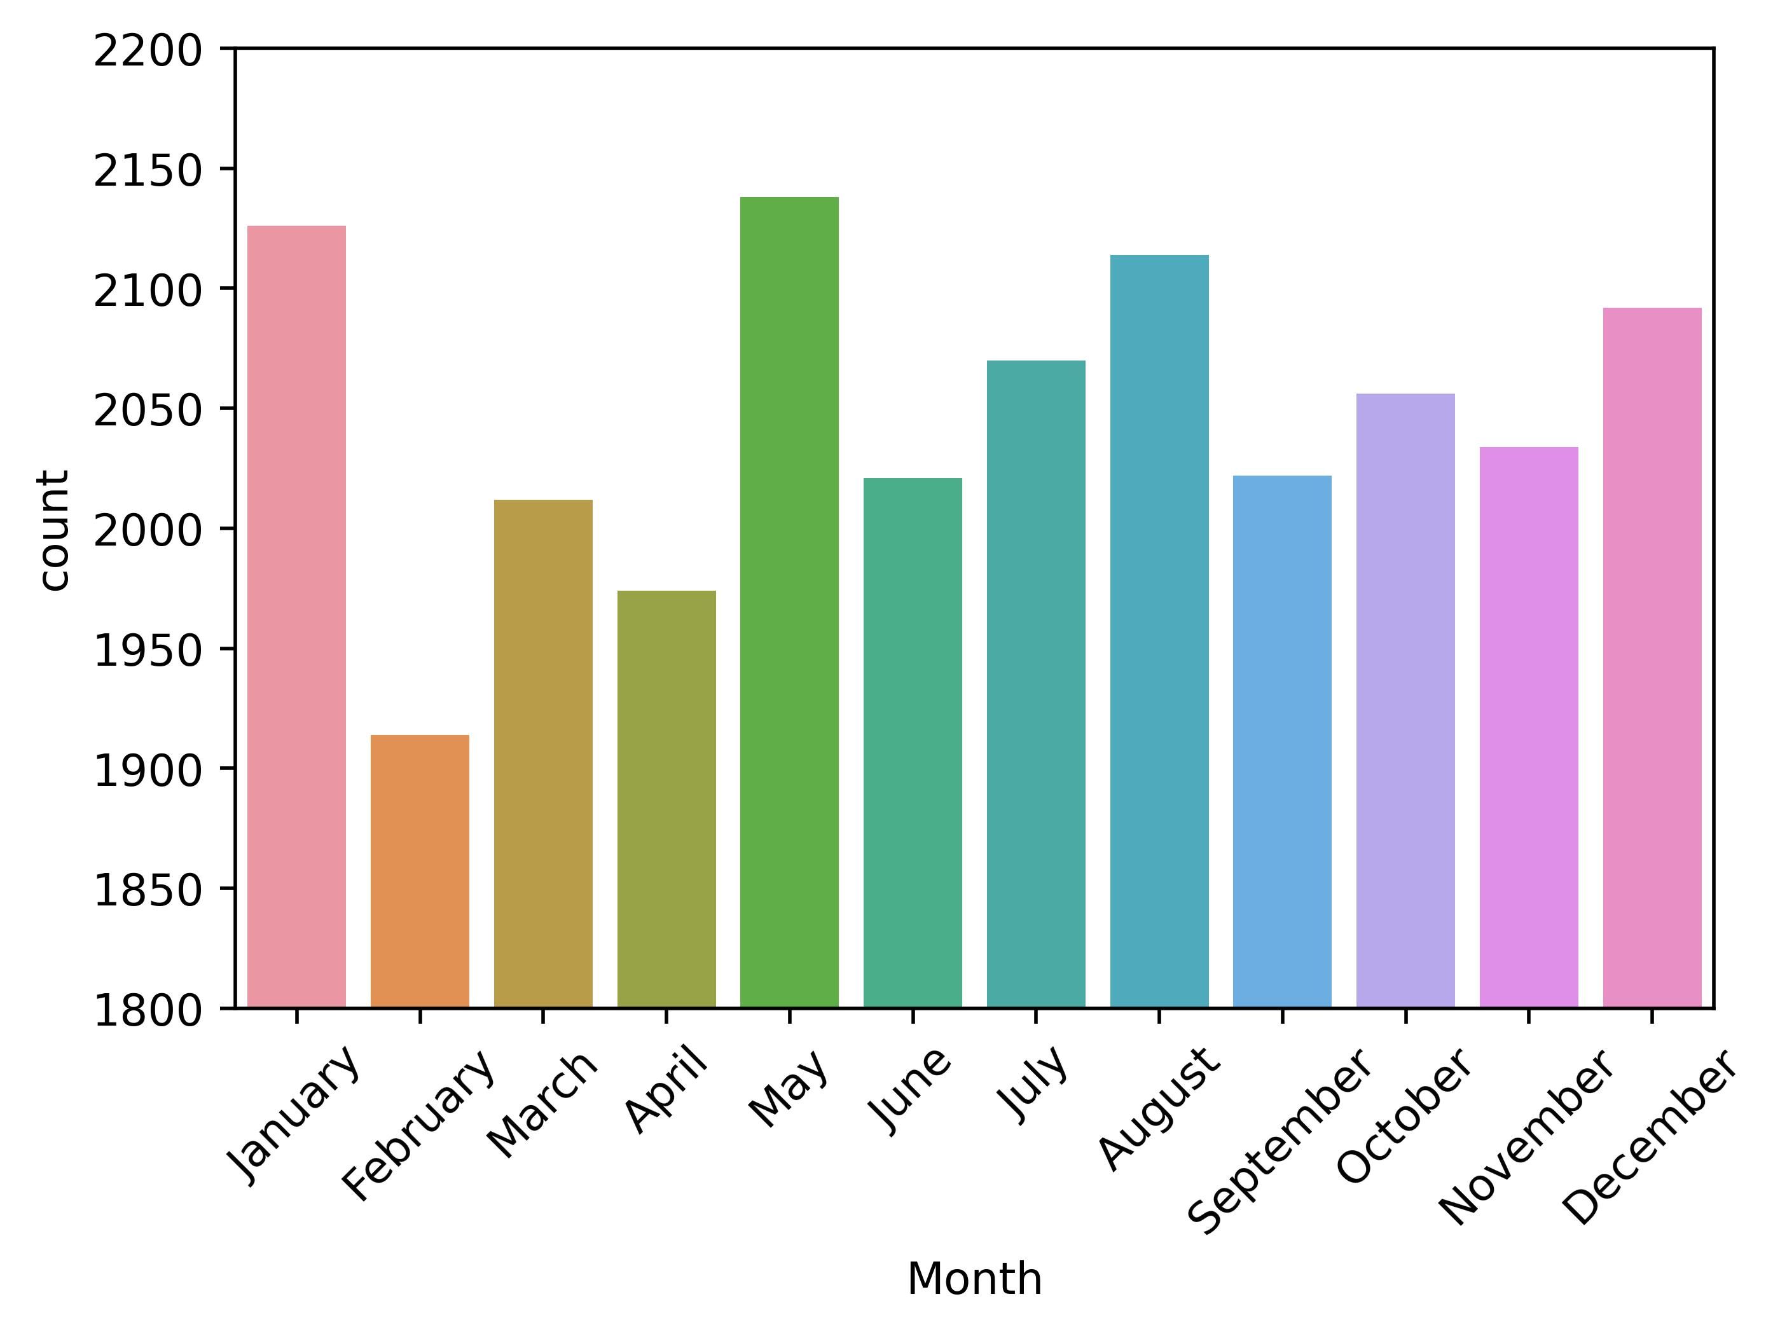
Content engagement by month

Slide 10

The top 5 content categories are Animals, Science, Healthy eating, Technology and Food.
The most common emotion associated with Social Buzz’s most popular content is Fear. Perhaps that is something to work on to prevent disengagement from users
Content engagement is lower during February, March and April. Perhaps advertisements should be done during these months.
Summary

Slide 11

Thank you!
ANY QUESTIONS?

